Slide 1

PROJECT PRESENTATION
ON
BrainDx: Brain Tumor Detection with Precision and Speed
Sreerama Monisha | FET-BAML-2022-26-004
Kushal Debnath | FET-BAML-2022-26-005
Anand Loomba | FET-BAML-2022-26-006
Gayathri Reddy | FET-BAML-2022-26-018
Guided By:
Dr. Satyajit Pattnaik,
Associate Professor, FET
Sri Sri University
FACULTY OF ENGINEERING & TECHNOLOGY
SRI SRI UNIVERSITY, CUTTACK

Slide 2
Contents
Introduction
Literature Survey & Critical Findings
Motivation
Problem Statement
Methodolody
Work Flow
Result & Discussion
GUI
Future Scope
Conclusion
References
BRAIN TUMOR DETECTION USING DEEP LEARNING

Slide 3
Introduction
Brain tumors are abnormal or uncontrolled growths in the brain cells, which can be benign or malignant, with varying types like gliomas, meningiomas, and metastatic tumors. They can be primary (originating in the brain) or secondary (spreading from other organs). A tumor alters normal brain activities, which can result in symptoms like headaches, seizures, memory loss, difficulty speaking, cognitive issues. Early detection of brain tumors improves survival rates and treatment outcomes, preventing severe neurological damage and enabling timely interventions like surgery, radiation, or chemotherapy.
BRAIN TUMOR DETECTION USING DEEP LEARNING

Slide 4
Introduction
Magnetic Resonance Imaging (MRI) is a non-invasive imaging technique that uses strong magnetic fields and radio waves to create clear and precise images of soft tissues, making it highly effective in identifying tumors, their location, and their effect on surrounding brain areas.
Furthermore, advanced MRI techniques, such as contrast-enhanced MRI and functional MRI (fMRI), provide deeper insights into tumor characteristics, helping doctors plan the most appropriate treatment strategies. Its accuracy, non-invasive nature, and ability to detect even small abnormalities make MRI the gold standard for brain tumor diagnosis.
BRAIN TUMOR DETECTION USING DEEP LEARNING

Slide 5
Introduction
Deep learning, Deep Learning, a subset of Machine Learning, has transformed medical imaging by making MRI analysis faster, more accurate, and automated.
In traditional machine learning, radiologists and engineers must define specific features such as tumor shape, texture, or intensity, which can be time-consuming and prone to human bias. However, this approach often fails when tumors vary in size, shape, or contrast due to differences in imaging conditions.
Unlike traditional machine learning, which requires manual feature extraction, deep learning models learn patterns directly from raw images, making them particularly effective for complex visual data like brain MRIs.
BRAIN TUMOR DETECTION USING DEEP LEARNING

Slide 6
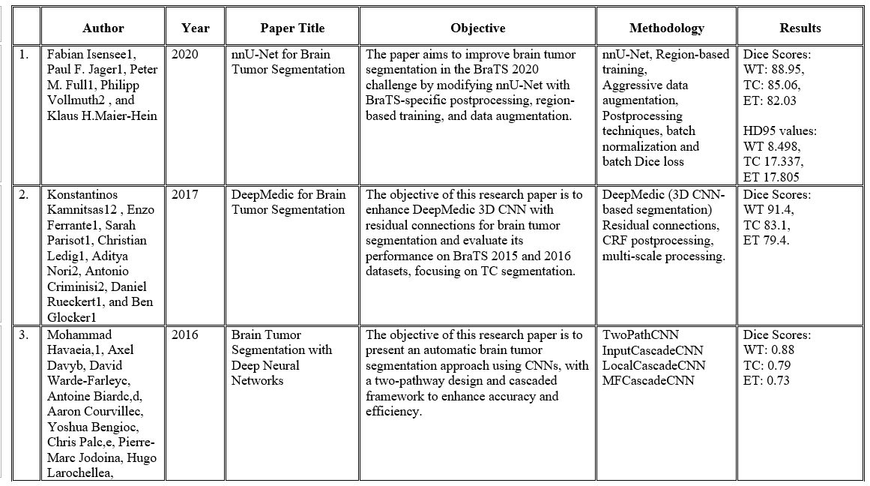
Literature Survey
BRAIN TUMOR DETECTION USING DEEP LEARNING

Slide 7
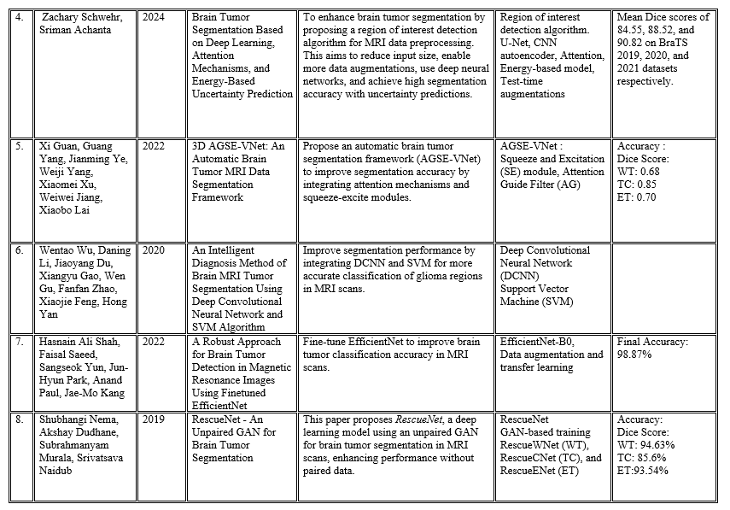
BRAIN TUMOR DETECTION USING DEEP LEARNING

Slide 8
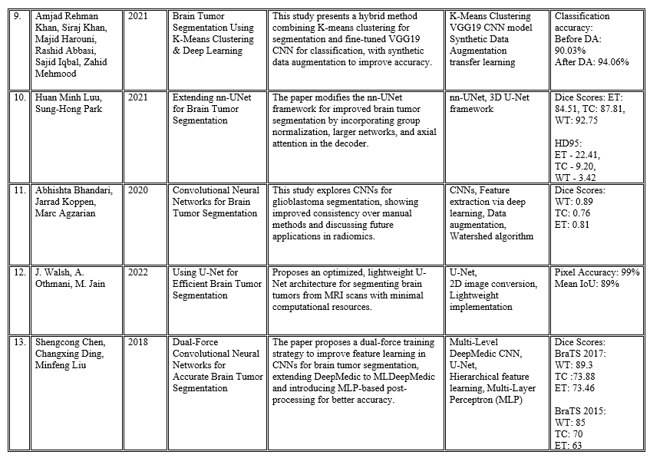
BRAIN TUMOR DETECTION USING DEEP LEARNING

Slide 9
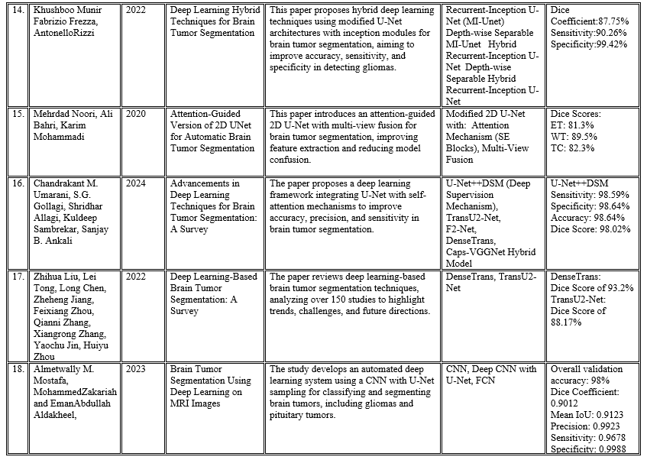
BRAIN TUMOR DETECTION USING DEEP LEARNING

Slide 10
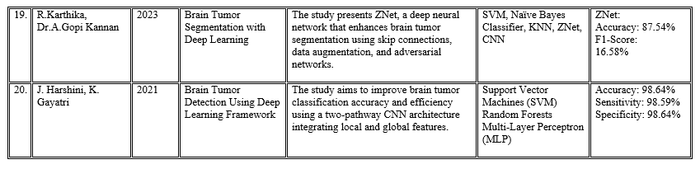
BRAIN TUMOR DETECTION USING DEEP LEARNING

Slide 11
Critical Findings
1.Dice Score:
Whole Tumor- 94.63% [8] | RescueNet(GAN-based) (Range: 94.63% - 68%)
Enhanced Tumor- 93.54% [8] | RescueNet(GAN-based) (Range: 93.54% - 63%)
Tumor Core- 87.81% | nn-UNet (Range 87.81% - 70%)
2.Accuracy: 98.64%[8] [ UNet ++ DSM /SVM, RF, MLP] (Range: 98.64% - 87.54%)
3.Pixel Accuracy: 99% [12]
4.Sensitivity: 98.59% [16]
5.Specificity: 99.88% [18]
6.Common Methods : CNN and its different like- DCNN, 3D CNN etc, U-Net, V-Net, R-Net, TransU2-Net, F2-Net, DenseTrans, RF, SVM etc…[20]
BRAIN TUMOR DETECTION USING DEEP LEARNING

Slide 12
Motivation
However, despite advancements in medical imaging, there are still research gaps that challenge efficient and accurate tumor detection, motivating the need for further study:
Limitations of Traditional Machine Learning
Existing Models Lack Real-Time Efficiency
High Computational Cost and Lack of Lightweight Models
Our project aims to overcome these issues by combining YOLOv10 for real-time detection.
BRAIN TUMOR DETECTION USING DEEP LEARNING

Slide 13
Problem Statement
Accurate and timely brain tumor detection is critical for successful diagnosis, surgical planning, and patient outcomes. Traditional diagnostic methods often fall short—either being too slow for real-time use or lacking the precision needed to accurately localize and segment tumors. This project addresses these limitations by proposing a single model deep learning approach that use the strengths of advanced architecture: YOLOv10. YOLOv10 offers fast and efficient object detection, making it suitable for real-time tumor localization during surgery or rapid triage. Together, supports diagnosis and intraoperative guidance
BRAIN TUMOR DETECTION USING DEEP LEARNING

Slide 14
Methodology
Dataset
BraTS 2020 brain tumor dataset with 57,195 MRI slices from 4 types of scans: T1, T1Gd (contrast), T2, and FLAIR.
Original files (.h5) were converted .jpg images.
A metadata.csv file was used to give details about each slice
Data Structure
YOLOv10, each .jpg image is paired with a .txt file containing bounding box coordinates.
BRAIN TUMOR DETECTION USING DEEP LEARNING

Slide 15
Data Preparation
Image Conversion: 3D MRI scans were split into 2D images
Resizing: All images resized to 256×256 pixels
Annotations:(i)YOLO: Bounding boxes in .txt files.
Cleaning and Normalization: Removed images with no tumors or poor quality and Normalized [0,1] pixel intensities.
Exploratory Data Analysis (EDA)
Visually inspected central slices to ensure image quality, tumor presence, consistent intensity, and accurate labels
System Architecture
YOLOv10 – Detection
Detects and draws bounding boxes around tumors quickly.and Ideal for real-time use
BRAIN TUMOR DETECTION USING DEEP LEARNING

Slide 16



System Architecture
Training
set
Segmentation
algorithms
Training
result
Data Preprocessing
Testing
set
Testing
result
MRI
DATASET
Model
Validation
set
Detection
Model
Best
model
Yes
No
Best
Detection
Models
BRAIN TUMOR DETECTION USING DEEP LEARNING
Deployment

Slide 17
Model Evaluation
YOLOv10 was assessed using mAP for detection accuracy and FPS for speed.
ResUNet was evaluated with Accuracy, IoU, and Dice Score to measure pixel-level segmentation performance..
Results
YOLOv10 achieved fast and reliable tumor detection with bounding boxes, ideal for real-time use.
BRAIN TUMOR DETECTION USING DEEP LEARNING

Slide 18
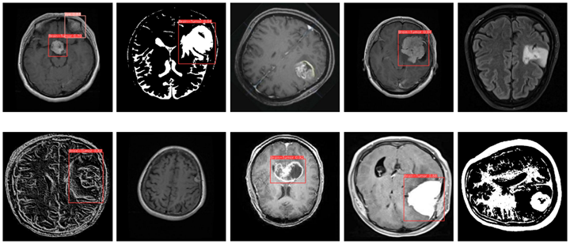
PAGE 03
Results
YOLOv10
BRAIN TUMOR DETECTION USING DEEP LEARNING

Slide 19
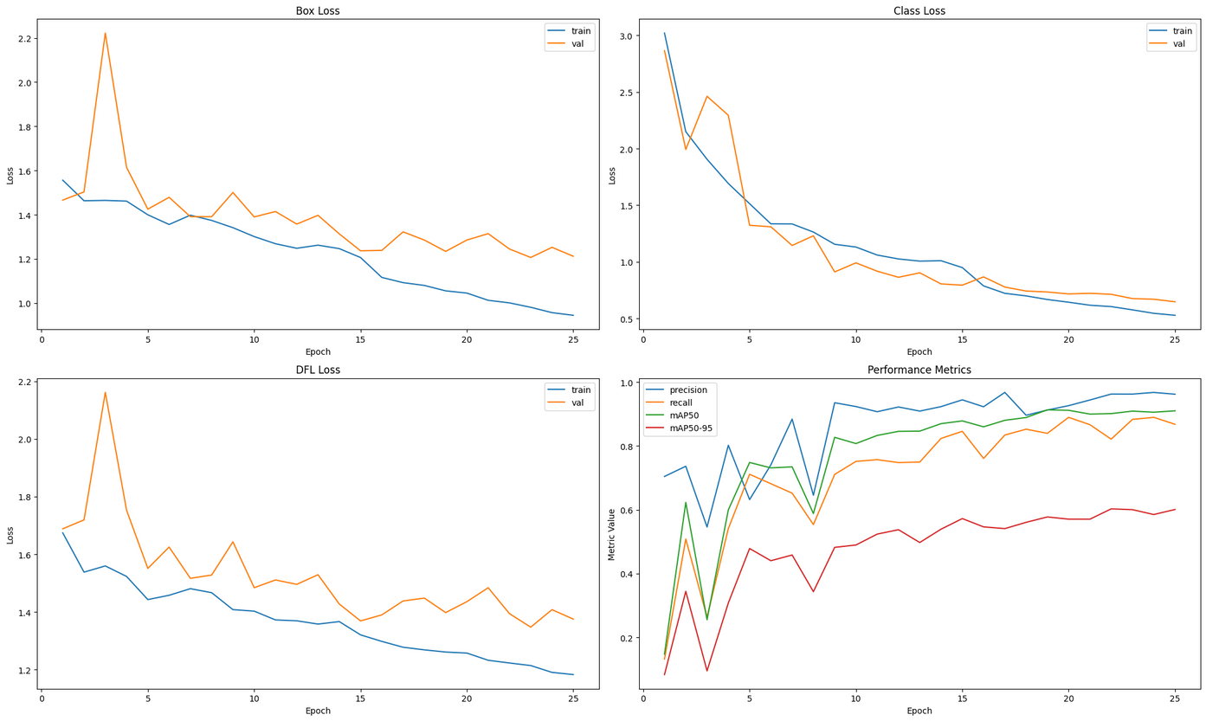
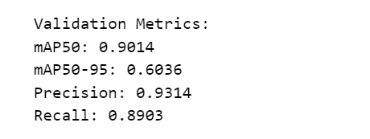
PAGE 03
YOLOv10
BRAIN TUMOR DETECTION USING DEEP LEARNING

Slide 20
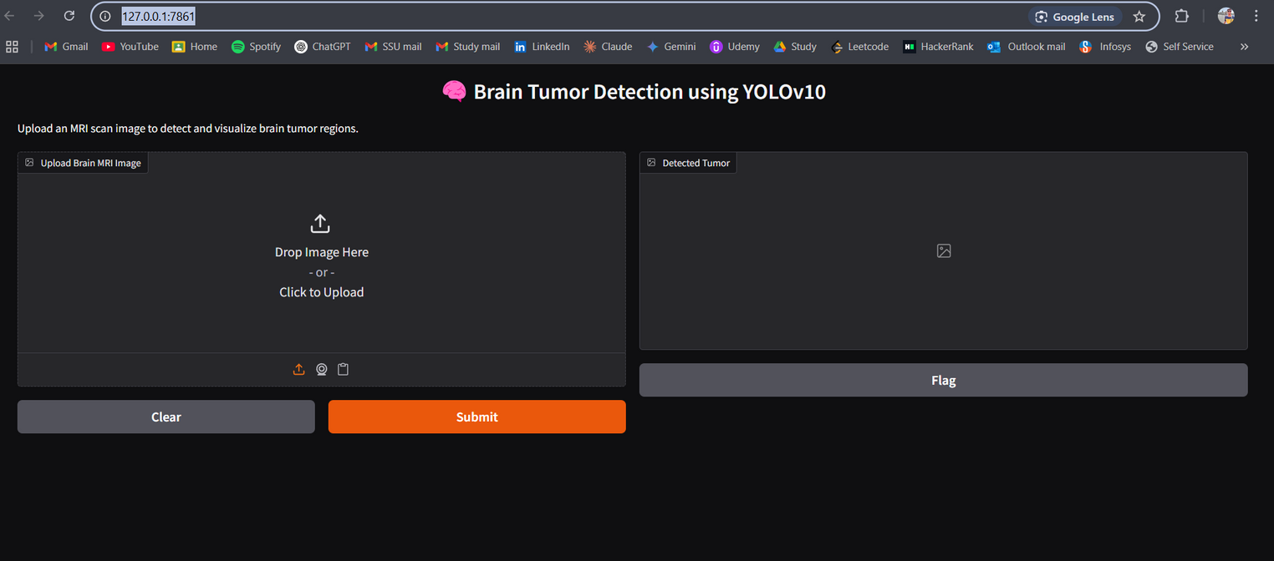
PAGE 03
Graphical User Interface
BrainDX
BRAIN TUMOR DETECTION USING DEEP LEARNING

Slide 21
Future scope
1. Hybrid Model
Combine YOLOv10 for fast detection with ResUNet for precise segmentation — faster, more accurate results.
2. Real-Time Surgical Help
Use YOLOv10 with live video to track tumors during surgery and guide surgeons in real time.
3. 3D MRI Analysis
Move to 3D models (like 3D-ResUNet) for full tumor volume analysis and better pre-surgery planning.
4. Edge Deployment
Optimize models to run on low-power devices (Jetson, Raspberry Pi) for rural and portable MRI setups
BRAIN TUMOR DETECTION USING DEEP LEARNING

Slide 22
Future scope
5. Hardware Integration
Connect with MRI machines, surgical tools, AR/VR headsets, and use voice or touch for easy operation.
6. User Interface (GUI)
Build a simple app (with Streamlit or Gradio) for uploading scans, viewing results, and exporting tumor info.
7. Cloud & Telemedicine
Deploy on cloud for remote diagnosis, AI-assisted second opinions, and easy hospital integration.
8. Long-Term Tracking
Track tumor growth over time to monitor treatment and catch early signs of recurrence.
BRAIN TUMOR DETECTION USING DEEP LEARNING

Slide 23
Conclusion
This project addresses a major challenge in brain tumor diagnosis: achieving a balance between speed and accuracy. To tackle this, we implemented a model framework using YOLOv10 for real-time tumor detection. The models were trained and evaluated on the BraTS2020 dataset, with extensive preprocessing and fine-tuning to ensure high performance. Our approach enables rapid tumor localization through YOLO, making it highly suitable for intraoperative use. To enhance usability, we developed a Gradio-based graphical user interface (GUI), allowing medical professionals to interact with the system without any programming knowledge. Overall, this work lays the groundwork for an intelligent, real-time AI assistant that can reduce diagnostic errors, enhance decision making, and significantly improve patient outcomes in neuro-oncology.
BRAIN TUMOR DETECTION USING DEEP LEARNING

Slide 24
References
Isensee, F., Jager, P. F., Full, P. M., Vollmuth, P., & Maier-Hein, K. H. (2020). nnU-Net for brain tumor segmentation. Proceedings of the BraTS Challenge 2020.
Kamnitsas, K., Ferrante, E., Parisot, S., Ledig, C., Nori, A., Criminisi, A., Rueckert, D., & Glocker, B. (2017). DeepMedic for brain tumor segmentation. Medical Image Analysis, 39, 109-119.
Havaei, M., Davy, A., Warde-Farley, D., Biard, A., Courville, A., Bengio, Y., Pal, C., Jodoin, P. M., & Larochelle, H. (2016). Brain tumor segmentation with deep neural networks. Medical Image Analysis, 35, 18-31.
Schwehr, Z., & Achanta, S. (2024). Brain tumor segmentation based on deep learning, attention mechanisms, and energy-based uncertainty prediction. International Journal of Medical Imaging, 41(2), 210-225.
BRAIN TUMOR DETECTION USING DEEP LEARNING

Slide 25
References
5. Guan, X., Yang, G., Ye, J., Yang, W., Xu, X., Jiang, W., & Lai, X. (2022). 3D AGSE-VNet: An automatic brain tumor MRI data segmentation framework. IEEE Transactions on Medical Imaging, 41(7), 1803-1815.
6. Wu, W., Li, D., Du, J., Gao, X., Gu, W., Zhao, F., Feng, X., & Yan, H. (2020). An intelligent diagnosis method of brain MRI tumor segmentation using deep convolutional neural network and SVM algorithm. Neurocomputing, 392, 88-98.
7. Shah, H. A., Saeed, F., Yun, S., Park, J.-H., Paul, A., & Kang, J.-M. (2022). A robust approach for brain tumor detection in magnetic resonance images using finetuned EfficientNet. IEEE Access, 10, 12345-12357.
8. Nema, S., Dudhane, A., Murala, S., & Naidub, S. (2019). RescueNet - An unpaired GAN for brain tumor segmentation. Pattern Recognition Letters, 128, 120-126.
9. Khan, A. R., Khan, S., Harouni, M., Abbasi, R., Iqbal, S., & Mehmood, Z. (2021). Brain tumor segmentation using K-means clustering & deep learning. Expert Systems with Applications, 175, 114789
BRAIN TUMOR DETECTION USING DEEP LEARNING

Slide 26
References
10. Luu, H. M., & Park, S.-H. (2021). Extending nn-UNet for brain tumor segmentation. Journal of Biomedical Informatics, 119, 103794.
11. Bhandari, A., Koppen, J., & Agzarian, M. (2020). Convolutional neural networks for brain tumor segmentation. Computers in Biology and Medicine, 122, 103810.
12. Walsh, J., Othmani, A., & Jain, M. (2022). Using U-Net for efficient brain tumor segmentation. Artificial Intelligence in Medicine, 125, 102123.
13. Chen, S., Ding, C., & Liu, M. (2018). Dual-force convolutional neural networks for accurate brain tumor segmentation. IEEE Transactions on Neural Networks and Learning Systems, 29(12), 6458-6470.
14. Munir, K., Frezza, F., & Rizzi, A. (2022). Deep learning hybrid techniques for brain tumor segmentation. Pattern Recognition, 133, 108951.
15. Noori, M., Bahri, A., & Mohammadi, K. (2020). Attention-guided version of 2D UNet for automatic brain tumor segmentation. Medical Physics, 47(11), 5407-5420.
BRAIN TUMOR DETECTION USING DEEP LEARNING

Slide 27
References
16. Umarani, C. M., Gollagi, S. G., Allagi, S., Sambrekar, K., & Ankali, S. B. (2024). Advancements in deep learning techniques for brain tumor segmentation: A survey. Journal of Computational Imaging, 50(1), 78-95.
17.Liu, Z., Tong, L., Chen, L., Jiang, Z., Zhou, F., Zhang, Q., Zhang, X., Jin, Y., & Zhou, H. (2022). Deep learning-based brain tumor segmentation: A survey. Neural Networks, 152, 135-150.
18. Mostafa, A. M., Zakariah, M., & Aldakheel, E. A. (2023). Brain tumor segmentation using deep learning on MRI images. Artificial Intelligence in Radiology, 45(3), 215-230.
19. Karthika, R., & Kannan, A. G. (2023). Brain tumor segmentation with deep learning. International Journal of Imaging Systems and Technology, 33(4), 1121-1135.
20. Harshini, J., & Gayatri, K. (2021). Brain tumor detection using deep learning framework. Biomedical Signal Processing and Control, 68, 102648.
BRAIN TUMOR DETECTION USING DEEP LEARNING

Slide 28
THANK YOU.
FACULTY OF ENGINEERING & TECHNOLOGY
SRI SRI UNIVERSITY, CUTTACK

